Slide 1
Agriculture & the Biofuels Industry
Unit 1, Lesson 2

Slide 2

Ethanol provides a value-added market for corn and other commodities
  Demand created by ethanol production increases the price a farmer receives for grain.
  An increasing number of farmers are joining together in cooperatives to build ethanol production facilities - thereby directly taking advantage of the value-added market through ownership.
  In 2013, 14 billion bushels of corn were grown in the U.S. From that and other biomass, 14.4 billion gallons of ethanol were produced. Of the 14 billion bushels of field corn produced in 2013, 35% was used as livestock feed, 34% went to ethanol plants, 9% was exported, and 13% was saved as surplus.
  Of the 34% that went to ethanol plants, 1.1 billion bushels of corn in the form of DDGS were returned to feed livestock. U.S. farmers will meet the challenge of a diversified market: Food, exports and energy.
  Ethanol mixed fuel is typically cheaper and can save the U.S. consumer money.
  Ethanol production in the U.S. accounts for approximately 7% of the nation’s fuel supply or the equivalent of 9.5 billion gallons of crude oil.

Slide 3
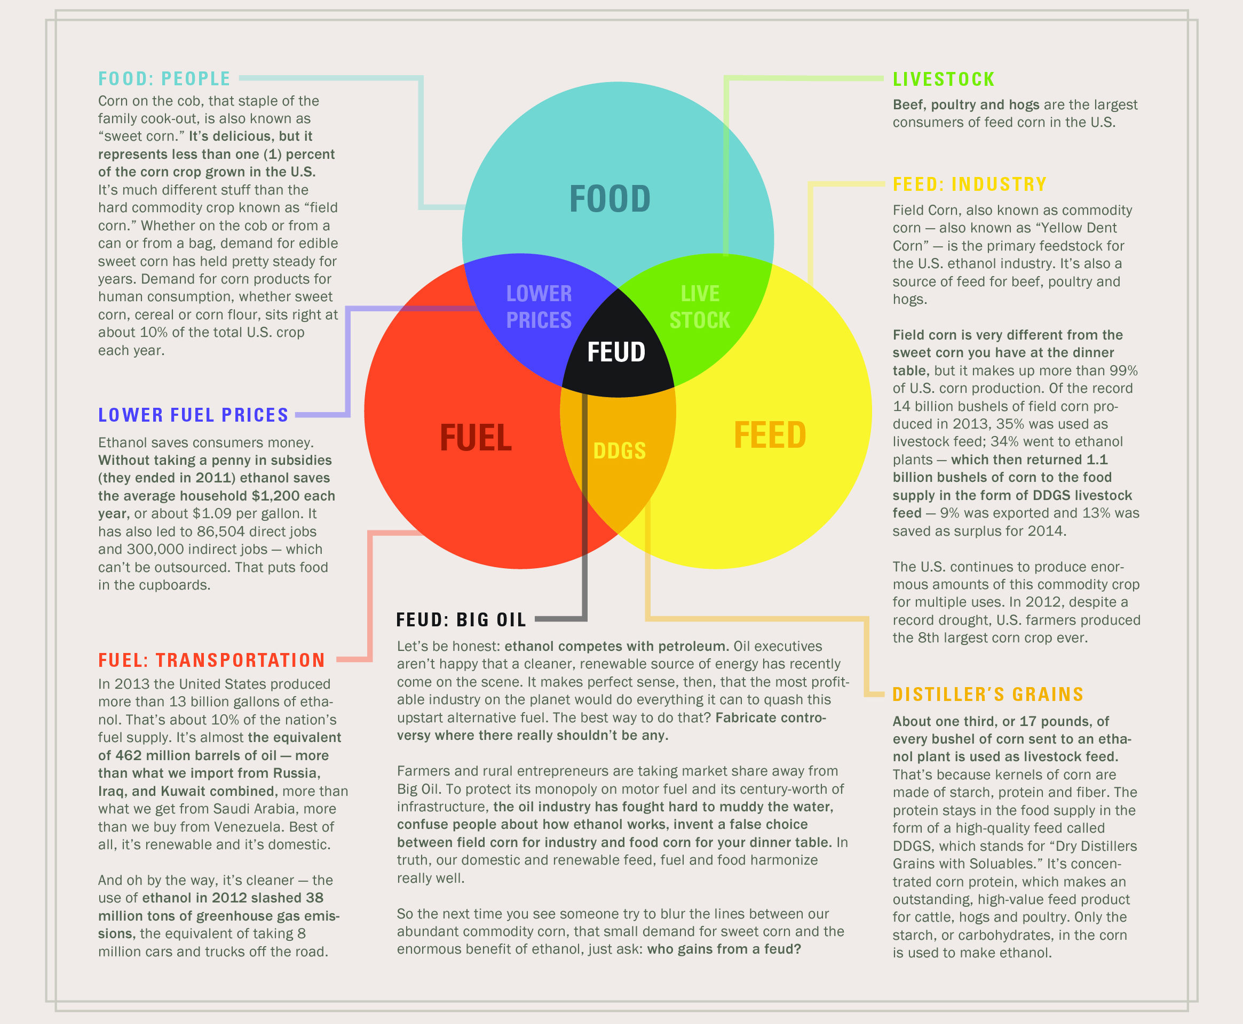

Slide 4
Biofuels impact on agriculture communities
In 2013, the U.S. spent approximately $_____ billion on imported crude oil. Producing and consuming biofuels in the U.S. can help guard against oil ______________, support the economy and strengthen our energy independence.
Approximately _____ billion gallons of biofuels were consumed in the U.S. in 2013. Most biofuels are produced from ___________, but they can also be produced from cellulose, and non-food sources like waste, energy crops and ________.
Cellulosic biofuels reduce ________________emissions by more than _____% when compared to petroleum-derived gasoline.
Approximately __________ U.S. jobs have been created by the biofuels industry. These jobs include _________, ___________, engineering, construction, ______________, and sales.
By 2030 up to ____ billion gallons of biofuels could be sustainable produced in the U.S. each year. This would displace nearly ____% of the nation’s current petroleum consumption by volume.

